Slide 1
Internship Use case 2025
December 2025

Slide 2
Important Information regarding Dataset
MIMIC-3: Medical Information Mart for Intensive Care 3
Publicly available deidentified patient record.
Records on 46520 patient stayed in critical care units of Beth Israel Deaconess Medical Center (at Boston) between 2001 and 2012.
It includes demographics, vital sign measurements, lab test results, procedures, medications, and clinical notes.
This slide is largely based on the information provided in MIMIC-3 version 1.4 tutorial website: q
Data Under Consideration
download the dataset
• Click here to get Detailed Information regarding dataset
• https://mimic.mit.edu/docs/iii/tables/
Notes:
Title With Text

Slide 3
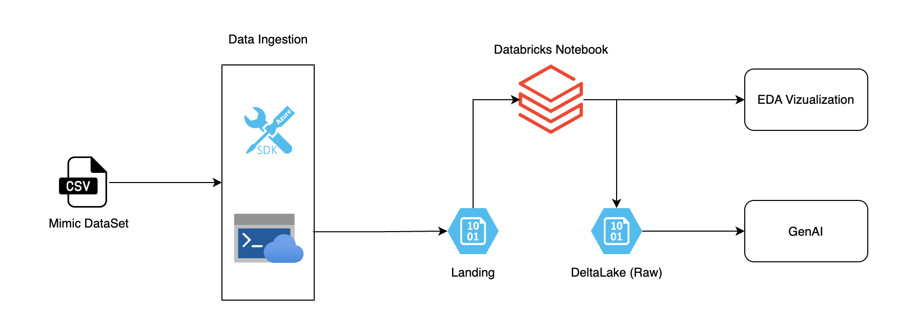
Suggestive Workflow
Notes:
Title With Text

Slide 4
High Level Activities
Secure the trial accounts for Azure/Databricks
Download the MIMIC Dataset
Develop programmatic Ingestion of Dataset on Azure Blob Storage
Create a databricks notebook for Data Analysis and Data Engineering
Perform the EDA(Exploratory Data Analysis) and present it
Develop Data Engineering Pipelines to land final data on DeltaLake (Raw Layer)
Perform Data Visualization
Create AI/GenAI application which will pick data from RAW layer
Notes:
Title With Text

Slide 5
Thank You
Notes:
Divider Slide

